Slide 1
Object Oriented Programming in C++
Day 1 :Orientation Class
Nepal College of Information Technology
Course Instructor: Er. Rabina Chaudhary

Slide 2
Evaluation:
 | Theory | Practical | Total
Sessional | 30 | 20 | 50
Final | 50 | - | 50
Total | 80 | 20 | 100

Slide 3
Internal Evaluation:
Theory [30]
Practical [20]
Assignment | 5
Tests | 5
Exam | 10
Attendance | 5
Performance | 5
Report | 5
Exam/ Performance | 5
Viva | 5
Attendance | 5

Slide 4
Course Objectives:
To familiarize with Object Oriented Concept
To introduce the fundamentals of C++
To enable the students to solve the problems in Object Oriented technique
To cope with features of Object Oriented Programming

Slide 5
Course Contents: Chapter Content Hrs.
Thinking Object Oriented
Object oriented programming a new paradigm, a way of viewing world agent, types of classes, computation as simulation, coping with complexity, nonlinear behavior of complexity, abstraction mechanism 4
Classes and Methods:
Review of structures, classes and inheritance, state, behavior, method, responsibility, encapsulation, data hiding, Functions: friend function, inline function, static function, reference variable, default argument 7
3 .Message, Instance and Initialization
Message, message passing formalization, message passing syntax in C++, mechanism for creation and initialization (constructor and its types), Issues in creation and initialization: memory map, memory allocation methods and memory recovery 6

Slide 6
Course Contents: Chapter Content Hrs.
4. Object Inheritance and Reusability
Introduction to inheritance, Subclass, Subtype, Principle of Substitutability; Forms of polymorphism and their implementation in C++,inheritance merits and demerits, composition and its implementation in c++, The is-a rule and has-a rule, Composition and Inheritance contrasted, Software reusability 9
5. Polymorphism
Polymorphism in programming language, Varieties of polymorphism, compile time polymorphism, function overloading, operator overloading, type conversion, polymorphic variable, run time polymorphism, object pointer, this pointer, virtual function, overriding, deferred method, pure polymorphism. 8
6 Template and generic programming
Generic and template functions and classes, cases study: container class and the standard template library, Exception handling 4

Slide 7
Course Contents: Chapter Content Hrs.
7. Object oriented Design
Reusability implies non- interference, Programming in small and programming in large, components and behaviors, role of behaviors in OOP, CRC, sequence diagram, Software components, formalizing the interface, interface and implementation, Design and representation of components, coming up with names, implementation components, integration of components 7

Slide 8
Procedure Oriented Programming
Programming model based upon the concept of calling procedure
Importance is given to algorithms
Importance is given to operation on data not on the data itself and its security
Uses top-down approach in program design
Large programs are divided into smaller programs called functions

Slide 9
Object Oriented Programming
Programming model which is based upon the concept of objects
Programs are organized as cooperative collections of objects, each of which represents an instance of some class
Importance is given to data rather than the algorithm
Data and functions are tied together
Data protection or security of data is achieved by data hiding using access specifiers
Uses bottom up approach in program design

Slide 10
Characteristics of Object Oriented Programming
Classes
Object
Encapsulation
Inheritance
Polymorphism
Data Abstraction
Message Passing

Slide 11
Characteristics of Object Oriented Programming
1. Object :
Real world entities
Object is entity that has characteristics and behavior
Object is instance of a class
-If Ram is a Student than
He has characteristics like name, address, registrationNumber, marks
He has behavior like studying, taking exam, doing assignment

Slide 12
Characteristics of Object Oriented Programming
2. Classes :
A group of objects that share common characteristics and behavior
Example: Student
Student
Data : name rollNumber registrationNumber emailAddress Function : study() doAssignment() takeExam()

Slide 13
Examples of class and object
Class
Object
Student
Vehicle
Fruit
Animal
-Student1, Student2, Student3,…
-Car, Motor bike, bus,...
-Orange, apple, grapes,…
-Dog, Cat,…

Slide 14
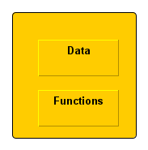
Characteristics of Object Oriented Programming
3. Encapsulation :
Binding together the data and functions
Prevents the data from unauthorized access

Slide 15
Characteristics of Object Oriented Programming
4. Inheritance :
Ability to create new classes from the already existing class
The existing class is called base class and the new class is called derived class
Property of base class is inherited by derived class
Derived class has data and functions of its parent class as well as its own data and functions
Inheritance supports reusability

Slide 16
Characteristics of Object Oriented Programming
5. Data Abstraction:
Abstraction refers representing only essential features or information and hiding background details
6. Polymorphism:
Polymorphism means having many form
Polymorphism can be achieved through function overloading and operator overloading

Slide 17
Characteristics of Object Oriented Programming
7. Message Passing :
Objects communicate with each other by sending and receiving information to each other to perform certain task
Message for an object is a request for execution of a procedure
Invoke the function in receiving object that generates the desired result
Object.functionName(information)

Slide 18
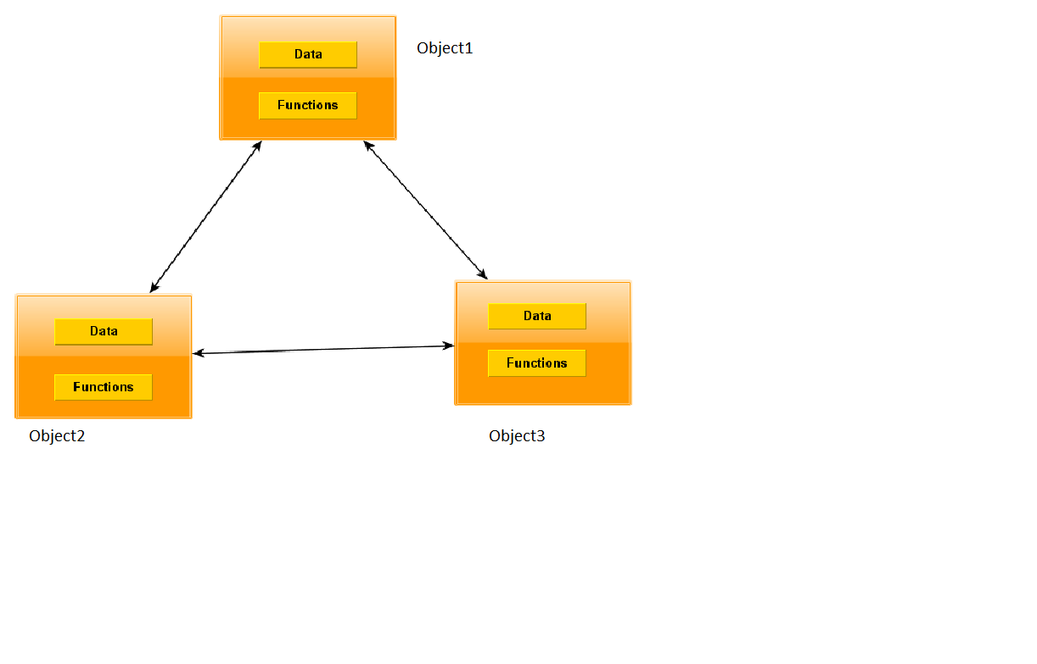
Break down of object oriented program

